Slide 1
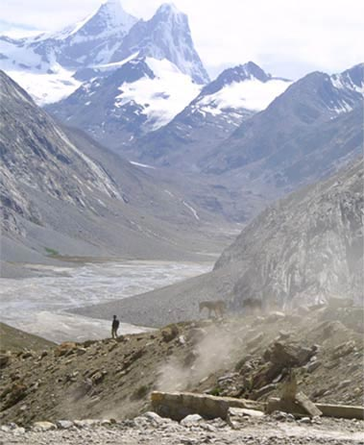
Fellowship of the Heart
Getting Started — the Four Connects, walked around the table on alternating evenings
Evening Series 2026–27 · at the Tittle home · v1.5E DRAFT
All Scripture: ESV · The Companion lesson plans carry the full scripts — these slides carry the room
1
Notes:
DECK TITLE · pre-session · DIVIDER
On screen as the room assembles on night one. All Scripture ESV; the plans carry the scripts; these slides carry the room — and these notes carry you.

Slide 2

SESSION 17
The Float
The evening that absorbs the year’s surprises — or walks the rhythm together
Quarter 3: Mission & Rhythm
209
Notes:
S17 · pre-session · DIVIDER
On screen through dinner and as the circle forms. Greet at the door — the slide holds the room.

Slide 3

Session 17 — Tonight’s Road
1 Mode A — a missed evening’s plan runs tonight, whole and unchanged
2 Mode B — the live Rhythm-Card walk: leaders first, slipped cards welcome
3 The borrow round — take ideas from each other’s cards shamelessly
4 Quarterly Pulse returns to the bin at the door
5 One practice chosen to carry across the break
6 The Leader Feedback Round — both leaders
7 Closing container + Aaronic blessing
210
Notes:
S17 · 7:00–8:30 · LEAD: BOTH LEADERS · DUAL MODE — confirm A or B before the night
BEATS: 1. Today is the Float, the quarter's shock absorber, and it runs ONE of two modes, decided by what the quarter needs: an evening was lost (snow, assembly, illness) = Mode A, that session runs whole; the quarter ran clean = Mode B, the room walks its Rhythm Cards together. 2. The call was made at the team prep meeting, 48 hours out — never game-day — and families were told by the weekend before. Confirm with the team which mode was called, and prepare from that mode's plan. 3. Either mode: the Pulse bin sits at the door, one break practice is commissioned, and the feedback round and blessing close the quarter.

Slide 4
Mode A — The Missed Evening Runs Whole
• If the quarter lost an evening — the snow, the assembly, the bug — tonight runs that session's plan, unchanged
• “Tonight is not a make-up class squeezed in. Tonight IS [session name] — whole, unhurried, the evening you were always going to get.”
• “Nothing was skipped this year; it just moved.”
• The lifted plan runs whole — its blocks, its scripts, its splits; only its closing yields to tonight's quarter-close constants
PROVERBS 16:9 (ESV)
“The heart of man plans his way, but the LORD establishes his steps.”
211
Notes:
S17 · 7:00–8:30 · LEAD: BOTH LEADERS · MODE A — THE LIFTED SESSION
BEATS: 1. Bless, then say the reframe once, warmly: we lost [date] to [cause]; this afternoon exists in the calendar for exactly this — today IS [session name], whole, not a make-up. Nothing was skipped; it just moved. 2. At 4:20 hand the room to the lifted plan — its blocks, scripts, splits, and watch-fors run from its own run sheet, prepped via the lift checklist at the prep meeting. 3. Today's constants resume at 5:13: the break practice, the feedback round, the close.
GUARD: Trim the lifted plan's closing, never its center. If the lifted session is teen-led, its leadership spec applies, re-rehearsed. Its crisis contingencies travel with it — re-read at prep.

Slide 5
Mode B — The Live Rhythm-Card Walk
• If the quarter ran clean, the whole room walks its actual Rhythm Cards aloud — “the real ones, not the ideal ones”
• The leaders walk first — and walk genuinely slipped cards honestly; the whole evening stands on that
• Two or three minutes each: daily, weekly, monthly, as lived — holds and slips in the same voice
• Glad out loud about holds; never guilt about slips — “a slip you noticed is the practice working”
• “If you want help with a slip, ask for it, and we will spend a minute on it together. If you do not, name it and keep walking.”
• Everyone walks their own card — parents never their teen's; pass-anytime holds tonight like every night
212
Notes:
S17 · 7:00–8:30 · LEAD: BOTH LEADERS · MODE B — THE RHYTHM WALK
BEATS: 1. Open: container, one word — we lost nothing this quarter; today we walk the real cards, not the ideal ones. 2. Proverbs 16:9, short: we planned the way; the LORD established the steps. 3. Leaders walk FIRST (4:28–4:38), genuinely slipped cards — the session stands on this; open with the slip. 4. The room walks (4:38–5:13): 2–3 min each, daily/weekly/monthly as lived; troubleshoot one minute only when invited; listen like a thief.
CUES: The arranged parent opens the room's round (Run Card) — never cold-call a teen; pass anytime.
GUARD: A noticed slip is the practice working — quote the Returning Rule from the front. Parents walk their OWN card, never their teen's. Perfect cards and eyes-down passes get a warm word after, not a spotlight. A slip that is really a household in trouble: bless it, don't troubleshoot, follow up in 48 hours.

Slide 6
The Borrow Round
• “Listen like a thief. If you hear an idea you want — a time of day, a trick, a place to keep the card — take it.”
• “That is not cheating. That is what a fellowship is for.”
• One sentence around the circle: one idea you heard tonight that you are stealing — name it, and the person you stole it from
• Fast, light — pass-anytime
213
Notes:
S17 · 8:18–8:20 · LEAD: CONTENT PRESENTER · MODE B, SHARED CIRCLE
BEATS: 1. Fast and light: one sentence each — one idea you heard today that you are stealing, and who you stole it from. 2. Stealing is the point — that is what a fellowship is for. 3. Then move straight into the break-practice commissioning; it shares this window.
CUES: Pass anytime; keep the round quick — the commissioning needs its minutes.

Slide 7
Quarterly Pulse — Back in the Bin
• The return bin sits by the door — drop your Pulse 3 page as you arrive
• Nobody watches the bin; nobody is asked whether they dropped a page
• Spares sit beside it for those who forgot — a page next week is as welcome as a page tonight
• The team reads every page — the Quarter 4 planning conversation starts from what these pages say
214
Notes:
S17 · 6:00–7:00 arrival · EITHER MODE
BEATS: 1. The return bin sits by the door, labeled, spare Pulse pages beside it. 2. Pages drop in as families arrive — greeted, never checked. 3. Nobody watches the bin; nobody is asked whether they dropped a page; a page next week is as welcome as a page today.
GUARD: The bin is never a checkpoint. The team collects and reads every page this week — Quarter 4 is planned from them, and that promise is kept visibly.

Slide 8

One Practice Across the Break
• The break starts tomorrow — and we have done this before: at Christmas, every one of us carried one practice across the gap, and at The Return we heard what held
• Look at your card and choose ONE practice — just one — to carry through this break deliberately
• Not the whole card; the whole card can rest — that is sabbath, not failure
• Write it in your journal right now — the practice, and when, and where
• Then, one sentence around the circle: the practice you are carrying — “speaking it is part of carrying it”
• The Returning Rule travels: begin again on the next available day. At The Return II the first question will be the kind one: what held?
215
Notes:
S17 · late session, timed at the lab (Mode B / Mode A) · EITHER MODE
BEATS: 1. Name the precedent: this same move carried the cohort across Christmas, and it worked. 2. Choose ONE practice from your card — just one — carried deliberately through the break; the rest of the card is allowed to rest. Sabbath, not failure. 3. Write it in the journal NOW — the practice, when, where; give the room the full quiet minute. 4. One sentence around the circle: the practice you are carrying — speaking it is part of carrying it. 5. The Return II opens with the kind question: what held?
GUARD: Never minimize the break from the front — 'see you in a couple weeks' is how practices die. The Returning Rule travels: begin again on the next available day.

Slide 9
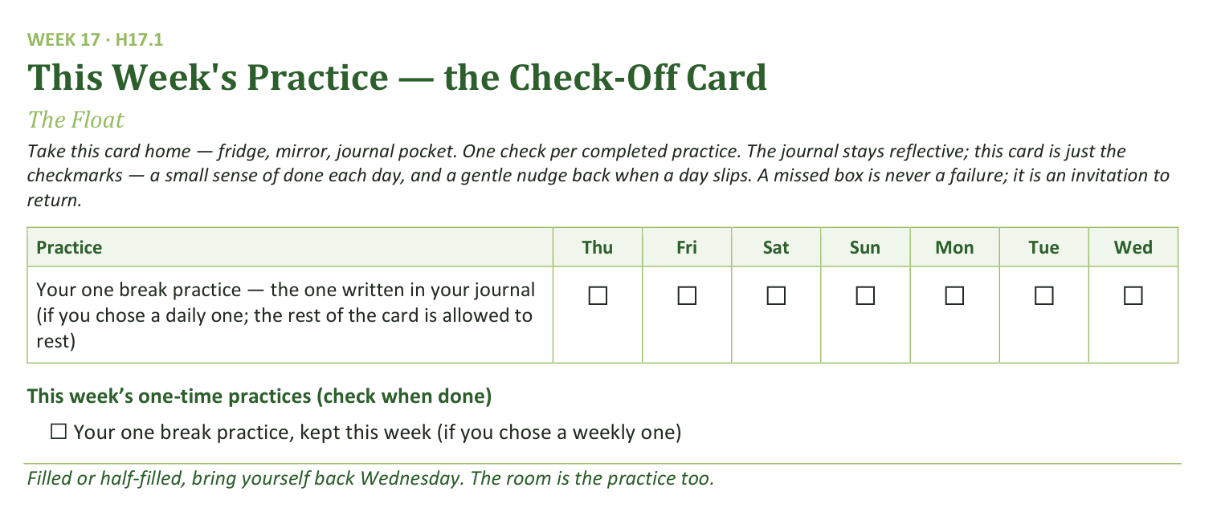
Your Take-Home Card — This Session’s Practice
Handed out now — fridge, mirror, journal pocket.
216
Notes:
S17 · closing, timed at the lab (B / A) · EITHER MODE
BEATS: 1. One row on the card: your one break practice, the one written in your journal — daily row if daily, weekly box if weekly. 2. Everything else rests on purpose — a card suspended on purpose beats a card half-kept in guilt. 3. A missed box is never failure — begin again on the next available day; see you at The Return II.

Slide 10
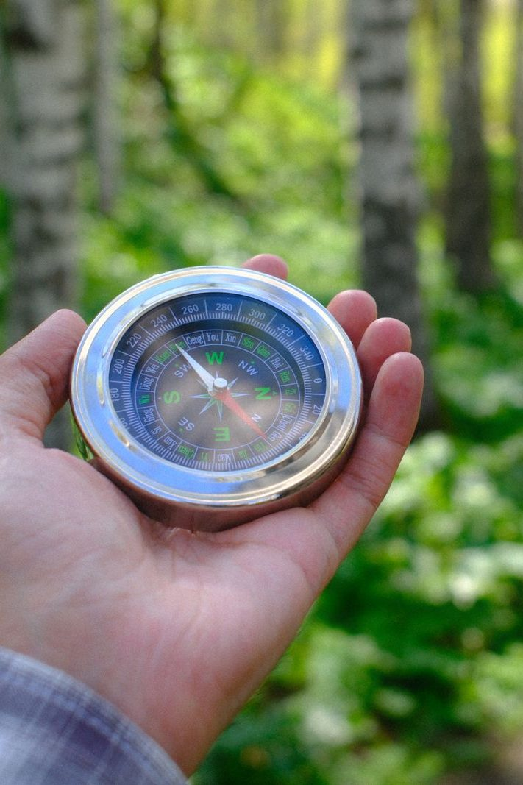
The Leader Feedback Round
• Two rounds, same as every session — the container holder first, then the content presenter: three things each
– “What I think went well tonight: ______”
– “What I’d do differently next time: ______”
– “If I were to teach tonight’s process to someone, I would tell them: ______”
• Then the room — the same two questions about tonight
• The leaders receive without defending — “thank you” is the whole response
217
Notes:
S17 · late session, timed at the lab (B / A) · EITHER MODE
BEATS: 1. The session's leader answers the three first — in Mode A that is the lifted session's leader, per its plan. 2. Then the room, same two questions — two or three voices each. 3. Receive without defending — 'thank you' is the whole response.

Slide 11
Closing the Container + Aaronic Blessing
• We close the way we opened — the container, six steps:
1 Stand again — same circle, same posture as the open
2 One-word landing — compare it to your opening word
3 The one thing you are taking from tonight
4 The one practice — committed aloud, or modified to one you will actually keep
5 Blessings — specific, witnessed, short
6 Closing prayer — and the Aaronic blessing, spoken over each other, face to face
THE AARONIC BLESSING — NUMBERS 6:24–26
“The Lord bless you and keep you;
the Lord make his face to shine upon you, and be gracious to you;
the Lord lift up his countenance upon you, and give you peace.”
218
Notes:
S17 · closing, timed at the lab (B / A) · EITHER MODE
BEATS: 1. Standing circle, one word each. 2. Name the quarter closed: three walked, one to go — consolidation and the two commissionings; dates come in the break communication. 3. The send: one practice on purpose, everything else rests; if even the one goes down, begin again on the next available day. The Return II asks the kind question first: what held? 4. Aaronic blessing. Go rest — see you on the other side.
CUES: Every family leaves knowing which Companion is reachable over the break, and how.

Slide 12
Quarter 4
Consolidation & Sending
Weeks 18–22 · Five Wednesdays · the mercy cards, The Long Walk, two commissionings
219
Notes:
Q4 · pre-session · DIVIDER
On screen through dinner and as the circle forms. Greet at the door — the slide holds the room.

